Slide 1
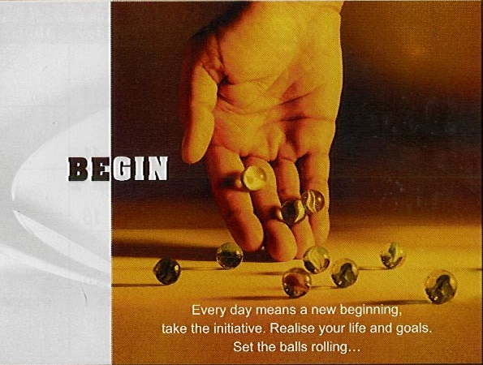
To unlearn…

Slide 2

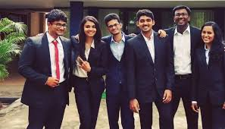
Misconceptions that surround IIT students…
IIT students are gifted in all spheres of life
They will be successful always, & never fail
Good students do not have personality problems
They do not require guidance for career & life, can take good decisions always
They are self-motivated & can withstand pressure or stress of any limit
Their interest and ability match always to meet personal, familial & social expectations
@Manas K Mandal

Slide 3
Reality faced by students today…
Alienation: loss of belongingness in society because of pre-occupation with digital world
Blind ambition: tendency to win at all costs, resulting in increased apprehension about outcome
Faulty coping strategy: lack of insight & flexibility about dealing with uncertain situations
Poor life skills: lack of skills necessary to build life beyond ‘expected’ career
Lack of resilience: difficulty in ‘bouncing back’ after failure
@Manas K Mandal

Slide 4

Profile of Today’s youth
Always connectable but stay detached
Capable of multi-tasking but make simple error
Reflect collectively but act individually
Stay in group but seek personal living space
Learn fast but have unique learning style
(touching, moving, experiencing)
@Manas K Mandal

Slide 5

What results in therefore…
Inability to perceive compatibility between career growth & teaching program
Incompatibility in interest & ability leading to confusion in target setting in life & career
Difficulty in sharing-in-person leading to gap in communication
Obsessed with reality-bound morality, thus crossing the laskhman-rekha of social norm
@Manas K Mandal

Slide 6

A tendency to suffer from frequent headaches
The feeling of being constantly under strain
Being excessively tired much of the time
Sensation of pressure in the head
Tremor, perspiration, racing of heart beat
Poor sleep, nightmare
Feelings easily hurt
Something to worry about always

Slide 7
Dwelling on negative aspects of past and future
Overreaction to life’s small problem
Expecting the worst to happen always
Wanting to make sure that everything is all right
Unable to take decision or to concentrate
Taking everything that goes wrong ‘personally’
Experiencing panic reaction at times without reason

Slide 8

Normal people do not get anxiety
Improved mood rules out depression
Personality does not change over years
Intelligent persons never fail
Happiness comes from satisfaction of self
Anger is a reflex, automatic & a masculine feature
Stress can be reduced by spending time leisurely
Compromising conflicting issues is adjustment

Slide 9

I don’t know how to control emotions
My efficiency is seldom recognized
I fail to impress others
I do not know how to stay away from bad dreams
I don’t know how to enhance my efficiency
I find it difficult to strike a balance of value & reality
I am unsure of how to remain motivated
I often get depressed without reason

Slide 10

Exercise to release endorphin, practice proactive skills
Avoid self-medication, & stop negative self talk
Maintain sleep – wakefulness cycle
Perform deep breathing exercise, muscle relaxation
Do not combat stress & make postural readjustment
Manage time effectively & do not take big decision
Improve attitude, Learn to say ‘No’

Slide 11

    Significant weight loss
    Insomnia or hyper-somnia
    Psychomotor agitation or retardation
    Fatigue or loss of energy
    Feelings of worthlessness or inappropriate guilt
    Diminished ability to concentrate
    Recurrent thoughts of negative ideation
    Markedly diminished interest in most activities

Slide 12
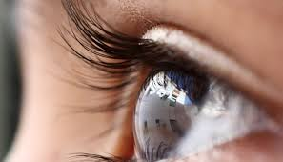
Don’t fight the depression – accept it as normal
Don’t watch anything that can depress you more
Don’t trust your memory right now - take notes, make lists
You will improve gradually…recovery takes time
Don’t be surprised if people are confused…
Hopeless thoughts are common in depression…talking
to someone professional about these can help

Slide 13

Guilt
Failure to live up to an important moral standard

Slide 14

Did the event really occur as you describe it to yourself ?
Is this a moral standard that you should respect ?
Is there an objective reason that it is an important
as you think it is ?
Are there steps you can take to recover the situation ?

Slide 15

Anger is not:
a reflex
automatic
uncontrollable
caused by others
Anger is:
a result of our thinking
a choice
controlled by our own
thinking

Slide 16

Recognize power of your thoughts
Realize you alone can control it
Always express anger somehow
Choose how much and for how long
Control your anger by controlling your thoughts

Slide 17

Creativity: Thinking of novel & productive
Curiosity: Taking an interest in ongoing experience
Open-mindedness: Nullifying bias
Love of Learning: Mastering new skills
Perspective: Providing wise counsel to others

Slide 18

Bravery: …not shrinking from challenge, difficulty, or pain
Persistence: … in the course of action in spite of obstacles
Integrity: …presenting oneself in the genuine way
Vitality: …energizing life; not doing anything half-heartedly

Slide 19

Let us not weaken our strengths…

